Slide 1
Superstore Sales Performance Dashboard
Data Visualization & Dashboarding Project
Prepared by: Odeh Olakunle Joshua
Tool: Microsoft Power BI
Dataset: Sample Superstore Dataset

Slide 2
Dataset Overview
The Sample Superstore dataset contains transactional sales records from a retail business in the United States. It includes information on customers, products, orders, sales, profit, quantity, discounts, and regions.
The objective of this project was to analyze business performance and build an interactive dashboard that communicates key business insights effectively.

Slide 3
Business Problem & KPIs
Business Problem
The business requires an interactive dashboard to monitor sales performance, profitability, customer orders, and product performance across different regions and categories.
Key Performance Indicators (KPIs)
- Total Sales
- Total Profit
- Total Orders
- Total Quantity Sold
- Profit Margin (%)

Slide 4
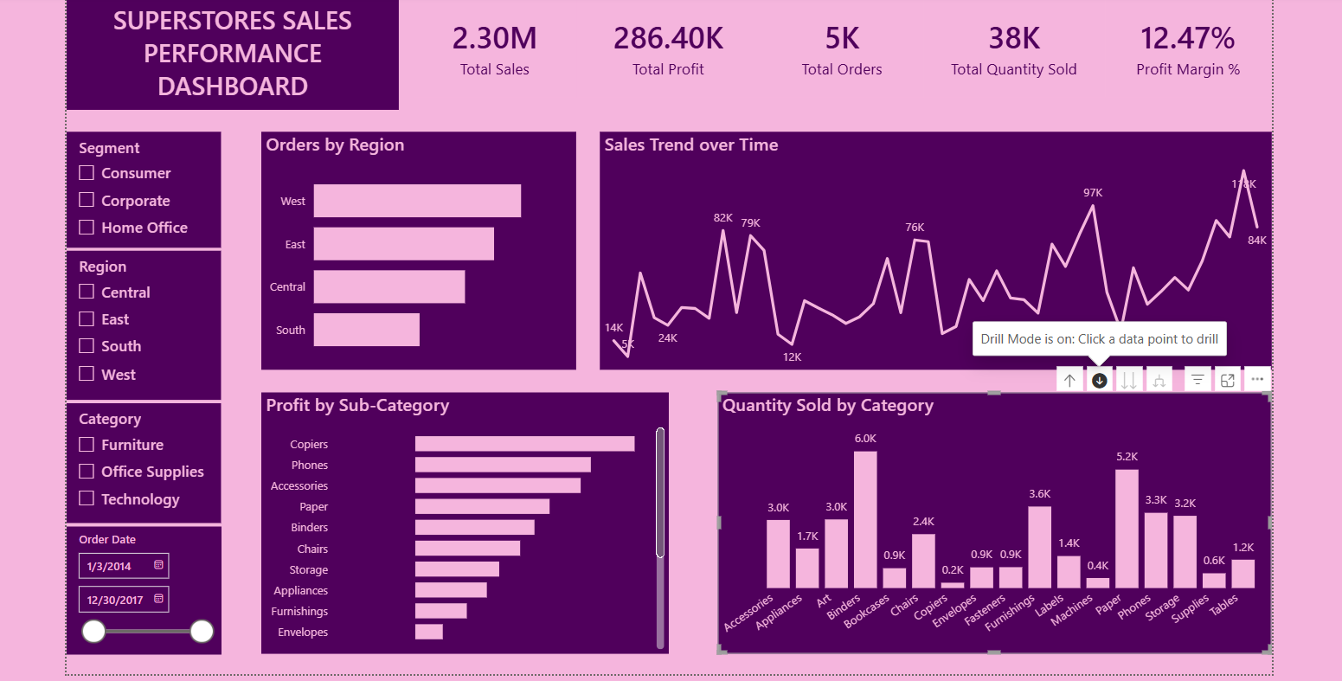
Interactive Dashboard
Interactive Power BI dashboard showing key business metrics, regional performance, sales trends, product categories, profitability, and dynamic filtering capabilities.

Slide 5
Key Insights
- Sales performance varies across different regions.
- Sales trends reveal changes in business performance over time.
- Product categories contribute differently to total quantity sold.
- Some sub-categories generate significantly higher profits than others.
- Interactive filters enable deeper analysis by region, category, segment, and order date.

Slide 6
Recommendations
- Focus on expanding sales in high-performing regions.
- Review underperforming sub-categories to improve profitability.
- Optimize inventory for high-demand product categories.
- Use dashboard insights to support data-driven business decisions.
- Monitor performance regularly using interactive filters.

Slide 7
Conclusion & Learning Outcome
This project strengthened my ability to build interactive dashboards using Microsoft Power BI. I learned how to transform raw business data into meaningful visual insights through KPI development, data visualization, drill-down analysis, and interactive reporting to support better decision-making.

